Slide 1
Office for the Advancement of Telehealth & Telehealth Resource Centers September 14, 2017 BPHC Telebehavioral Health Town Hall
Natassja Manzanero, MS
Telehealth Resource Center Program Coordinator
Office for the Advancement of Telehealth
Federal Office of Rural Health Policy Health Resources and Services Administration (HRSA)

Slide 2
Office for the Advancement of Telehealth
Mission
Funds grants to promote use of telehealth technology to improve quality and increase access to care in underserved communities
Funds research on the use of telehealth
Coordinates “FedTel” “cross-federal agency workgroup on to discuss common telehealth interests and activities

Slide 3
What is Telehealth?
HRSA defines telehealth as:
The use of electronic information and telecommunications technologies to support and promote long-distance clinical health care, patient and professional health-related education, public health, and health administration. Technologies include videoconferencing, the internet, store-and-forward imaging, streaming media, and terrestrial and wireless communications.
https://www.hrsa.gov/ruralhealth/telehealth/

Slide 4
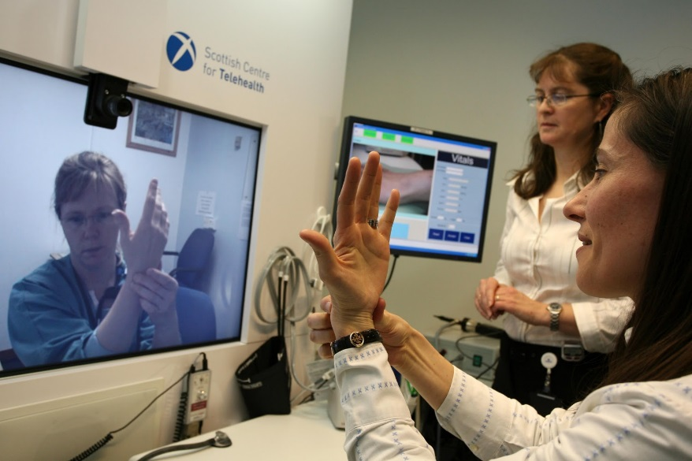
Telehealth Modalities
Synchronous interactive audiovisual
Asynchronous store-and-forward
Remote Patient Monitoring
Mobile Health
Robotics

Slide 5
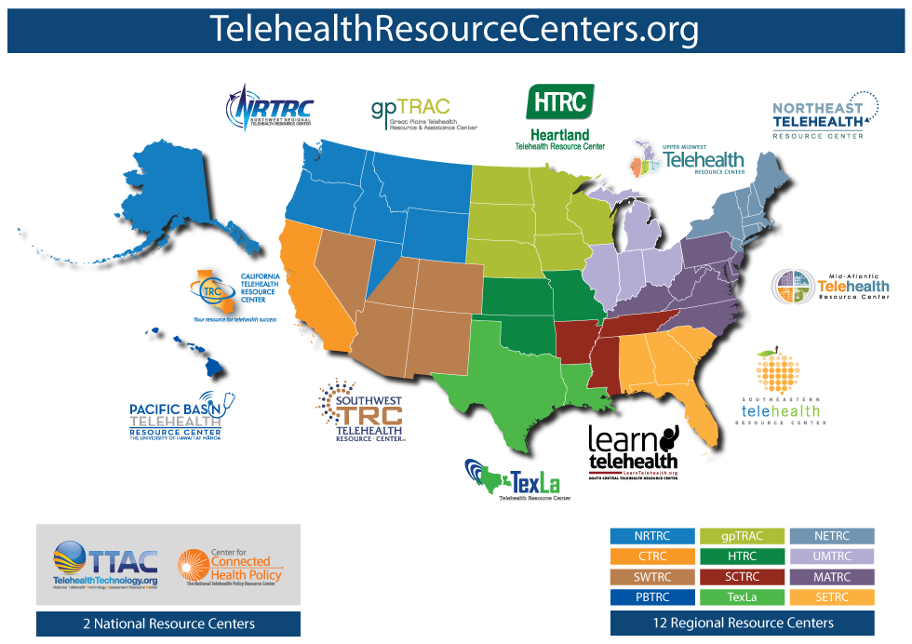
Telehealth Resource Centers

Slide 6
Telebehavioral Health and TRCs
Limited access to mental and behavioral health services in rural and underserved areas
Telebehavioral health can take two forms:
A non-behavioral healthcare provider can use telehealth technology to conduct a distance-based consultation with a behavioral health specialist to discuss how to handle a patient’s mental health needs (a consultation).
A patient can participate in a videoconference session with a behavioral health specialists (an encounter).
Both approaches have been successfully put in place by a select number of safety net programs funded by HHS and HRSA
Telehealth Resource Centers are an example of a HRSA program that can provide free technical assistance for implementing tele-behavioral health for safety net providers
https://www.hrsa.gov/publichealth/clinical/BehavioralHealth/behavioralhealthcareaccess.pdf

Slide 7
Potential Benefits of Telebehavioral Health
Travel time reduced/eliminated
Telehealth equipment costs have plummeted
Patients in distress can be seen more quickly, reducing relapse events
Consultations with off-site specialists can be quickly carried out
Off-site and part-time behavioral health specialists can be members of the clinic team via telehealth
Staff can meet and collaborate more easily, especially when connecting staff located at various sites
https://www.hrsa.gov/publichealth/clinical/BehavioralHealth/behavioralhealthcareaccess.pdf

Slide 8
Contact Information
Natassja Manzanero, MS
Telehealth Resource Center Program Coordinator
Health Resources and Services Administration (HRSA)
Email: nmanzanero@hrsa.gov
Phone: 301-443-2077
Web: www.hrsa.gov/ruralhealth
Twitter: twitter.com/HRSAgov
Facebook: facebook.com/HHS.HRSA

